Slide 1
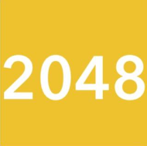
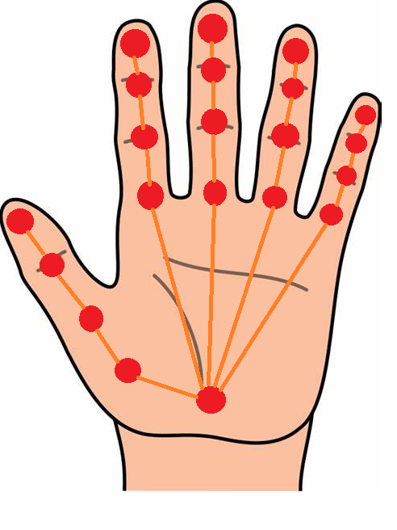
HAND
Playing one of the most popular computer games in a new and innovative way!
AI lab Project
By: Francesca Cinelli & Chiara Pennini

Slide 2
OVERVIEW
01
02
03
04
THE GAME
THE HANDS
THE GESTURES
THE OUTPUT
The main rules of the game 2048
The libraries used for hand detection
Translating gestures into commands
Showing the final output of the project

Slide 3
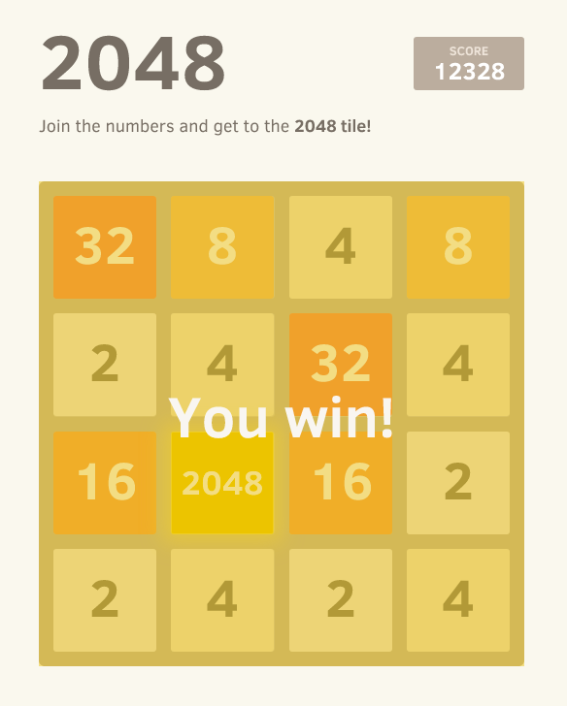
01
THE GAME
Main rules and implementation

Slide 4
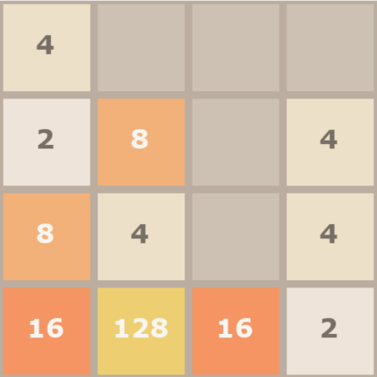
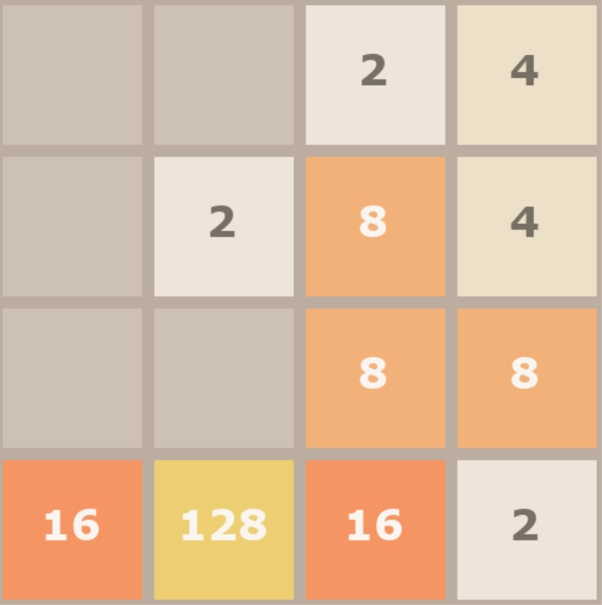
HOW TO PLAY 2048
The main objective is to reach the 2048 tile
This is done by moving the whole board, so each of the tiles on it, in a specific direction that we choose
The tiles containing the same number will be merged together if they bump into eachother during the movement
The tiles stop moving if they reach an obstacle
A new tile appears at each movement
Swipe Right

Slide 5

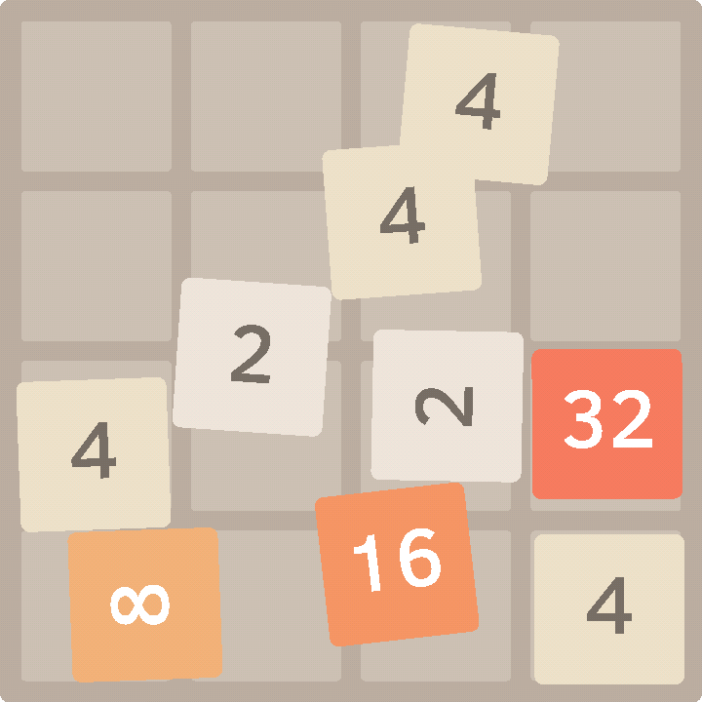
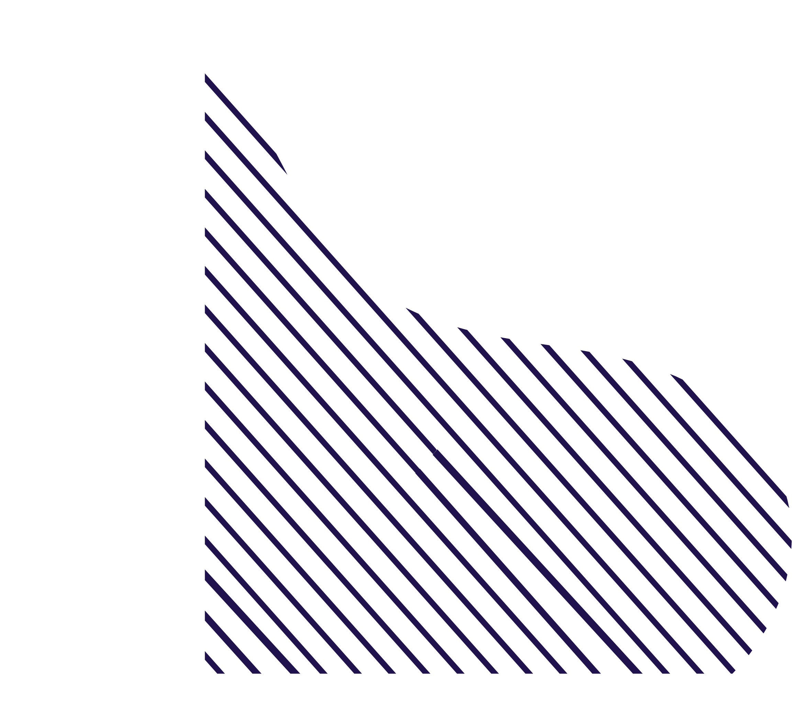
IMPLEMENTATION
To implement the game in python we used an existing model, that uses pygame, to actually run the game independently by using the WASD keys to move the tiles

Slide 6

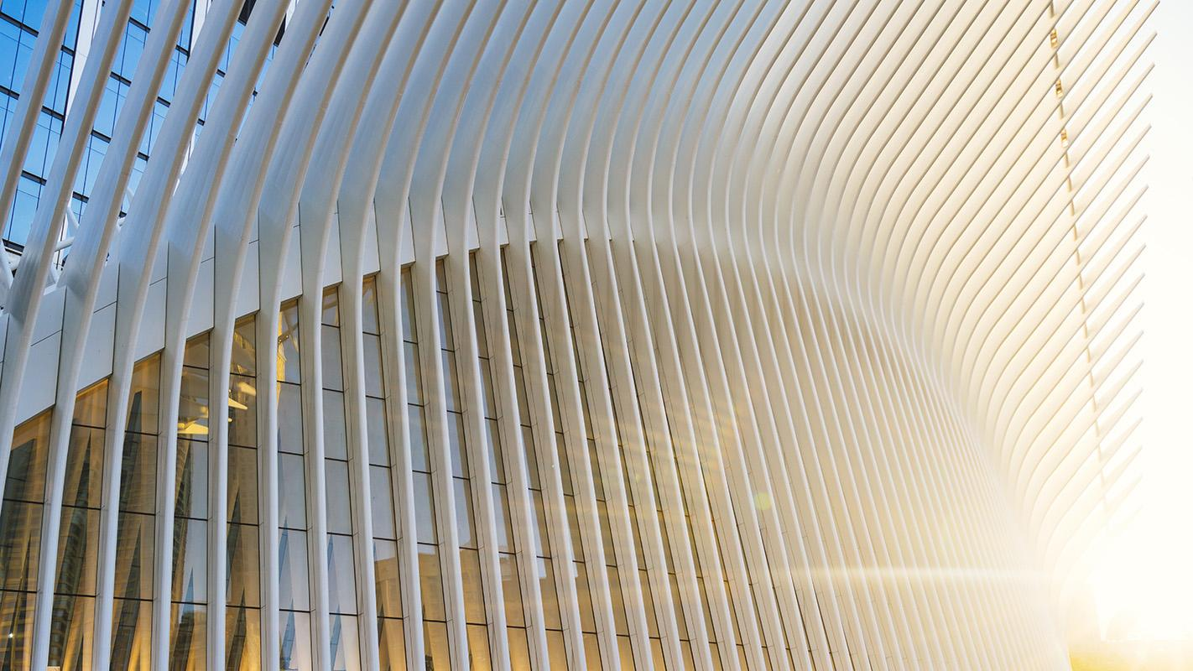
02 THE HANDS
The library we used for hand detection and understanding

Slide 7


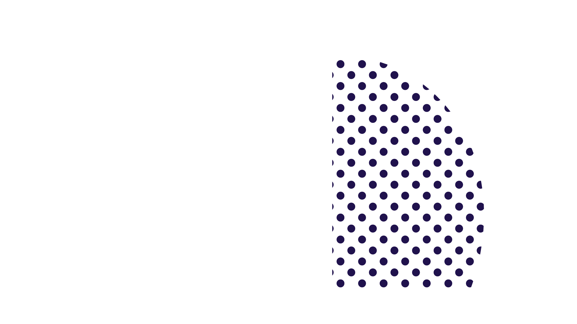
MEDIAPIPE
with mp_hands.Hands(
static_image_mode=False,
max_num_hands=1,
min_detection_confidence=0.5,
min_tracking_confidence=0.5) as hands:
Mediapipe is the main library used nowadays for hand detection, using landmarks to detect the main parts of the human hand

Slide 8
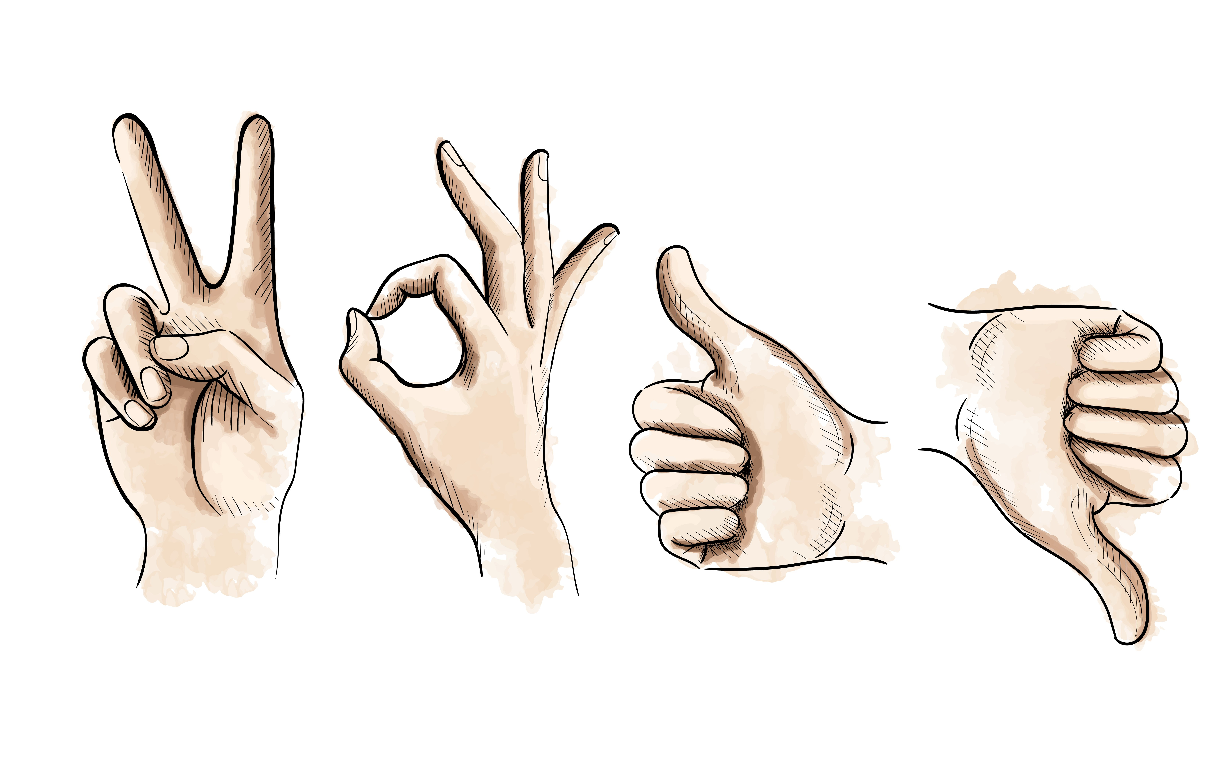
How we translated hand gestures into game commands
03
THE GESTURES

Slide 9

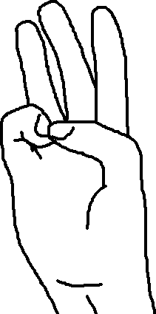
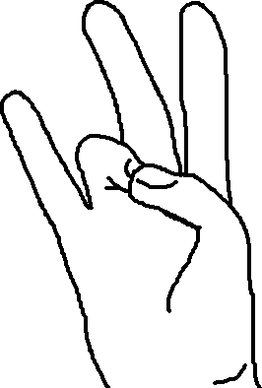

ASSIGNMENT
We had to assign each gesture to a specific action, but we encountered some problems, we also had to switch to pause mode and mouse mode

Slide 10
FLOW CHART of program states
thumb+pinky
CLICK BUTTONS
thumb+ring
PLAY GAME
thumb+pinky
PAUSE GAME
thumb+middle
MOUSE MODE
thumb+ring
(hold)
MOVE OBJECTS

Slide 11
TRANSLATION
MOVEMENT
GESTURE
COMMAND
While the hand moves, movement is tracked and gestures are observed
When a specific gesture is recognized by the program, it is translated into the corresponding command
The command is then sent to the main program of the game

Slide 12
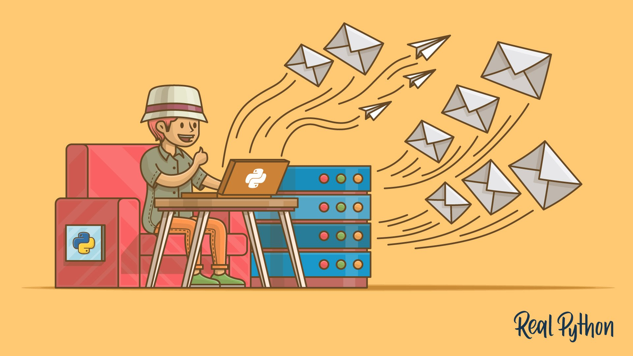
SENDING THE COMMANDS
W
A
LEFT
UP
S
D
DOWN
RIGHT
Pyautogui library to move the mouse and click
Keyboard library to simulate pression on the keys

Slide 13
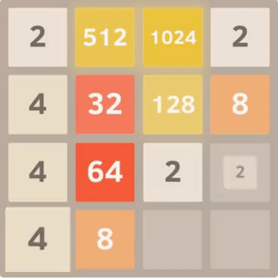
04 THE OUTPUT
The final output and demo of the game

Slide 14
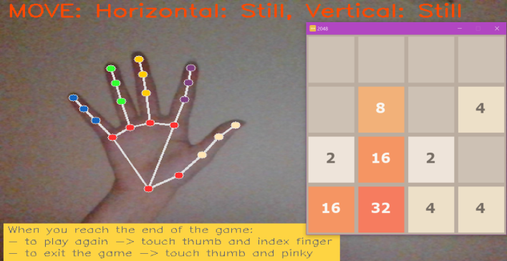
MAIN SCREEN
ACTION
1
HAND
2
INSTRUCTIONS
3
On the top part of the scren we have the action that is being performed
On the left part of the screen we have the video capture with the hand landmarks
On the bottom part of the screen we have the rules for ending the game, to keep them at hand
4
On the right part of the screen we have the main game screen
GAME

Slide 15
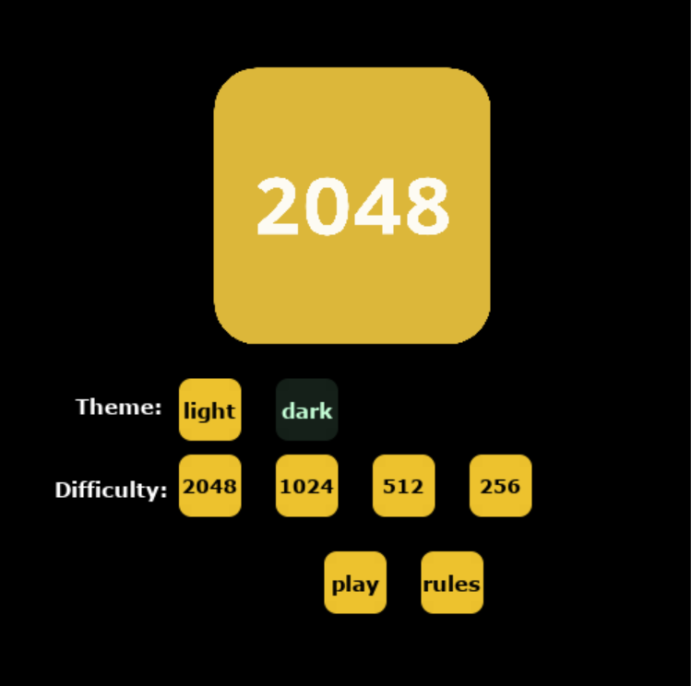
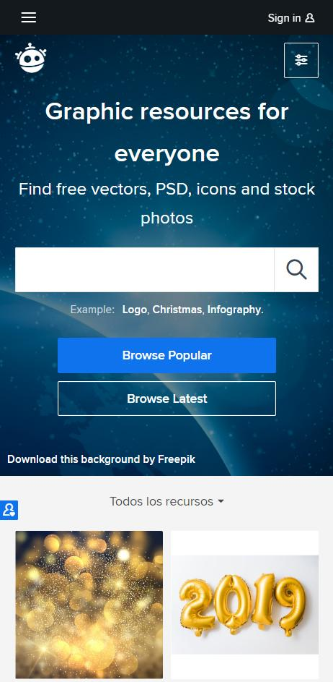
DEMO
We will show a quick demo of playing the game, using the mouse, entering pause mode, clicking and moving objects
NEPTUNE
Neptune is the eighth planet.

Slide 16

DEMO

Slide 17
FUTURE PLANS
GUI MANAGEMENT
With this implementation, we can reach a complete keyboard and mouse free computer
MULTIPLAYER
We would also like to extend the format to multiplayer games, like tic-tac-toe
NOT ONLY 2048
The aim is to extend this type of playing to other computer games, for example breakout

Slide 18
THANK YOU
2048
FOR YOUR ATTENTION!

